Slide 1

NAME – ABHIRUP BAG ROLL – 13000122082 DEPARTMENT – CSE(B) SEMESTER – 6 PAPER – Pattern recognition(pec-it602d)
NON-PARAMETRIC

Slide 2

content
Introduction
Key CONCEPTS
Common Non-parametric Methods
K-Nearest Neighbor Estimation
Support Vector Machines (SVM)
Comparison: KNN vs. SVM
Advantages & Disadvantages of Non-Parametric Estimation
Applications
Conclusion
REFERENCES
3
4
5
6 - 11
11 - 15
16
17
18
19
20

Slide 3
INTRODUCTION
What is Non-Parametric Estimation?
A statistical method that makes minimal assumptions about data distribution.
Unlike parametric methods, it does not assume a fixed functional form.
Why is it Important?
Useful for analyzing real-world data with unknown or complex distributions.
Provides more flexibility in modeling.

Slide 4
Key CONCEPTS
No Fixed Parameters : Unlike parametric methods (e.g., normal distribution with mean and variance), non-parametric methods do not assume a predefined shape for the data distribution.
Data-Driven Approach : These methods rely on the structure of the observed data to make inferences.
More Flexible but More Data Needed : Non-parametric methods adapt to data patterns but often require larger sample sizes to achieve similar accuracy as parametric methods.

Slide 5
Common Non-parametric Methods
Decision Trees
Support Vector Machines (SVM)
K-Nearest Neighbour Estimation(KNN)
Neural networks

Slide 6


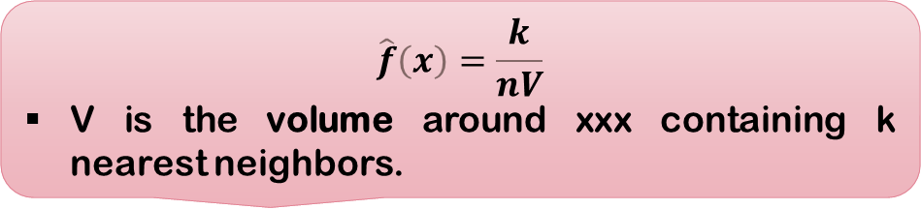
K-Nearest Neighbor Estimation (k-NN Density Estimation)
What is Nearest Neighbor Estimation?
Strengths & Weaknesses:
✔ Works well for high-dimensional data.
✘ Computationally expensive, especially for large datasets.
Determines the density of a point based on the distance to its k-nearest neighbor.
Provides a local density estimate based on proximity to other data points.
📌 Example: Used in anomaly detection (e.g., fraud detection in banking transactions).
Formula :
$$\hat{f}\left(x\right)=\frac{k}{nV}$$
V is the volume around xxx containing k nearest neighbors.

Slide 7
ALGORITHM OF k-NN Density Estimator
Select a value for k.
Find the k-nearest neighbors of the query point 𝑥.
Compute the volume V of the region containing these neighbors.
Estimate the density using the formula above.
1
2
3
4

Slide 8
Applications of knn
1
2
3
Anomaly detection (low-density regions indicate anomalies).
Probability estimation in machine learning.
Image processing (density-based segmentation).

Slide 9
Python Code to plot a k-NN Density Estimator
# KNN Density esitmator
gaussian = norm(loc=0.5, scale=0.2)
X = gaussian.rvs(500)
grid = np.linspace(-0.1, 1.1, 1000)
k_set = [5, 10, 20]
fig, axes = plt.subplots(3, 1, figsize=(10, 10))
for i, ax in enumerate(axes.flat):
K = k_set[i]
p = np.zeros_like(grid)
n = X.shape[0]
for i, x in enumerate(grid):
dists = np.abs(X-x)
neighbours = dists.argsort()
neighbour_K = neighbours[K]
p[i] = (K/n) * 1/(2 * dists[neighbour_K])
ax.plot(grid, p, color='orange')
ax.set_title(f'$k={K}$')
plt.show()

Slide 10

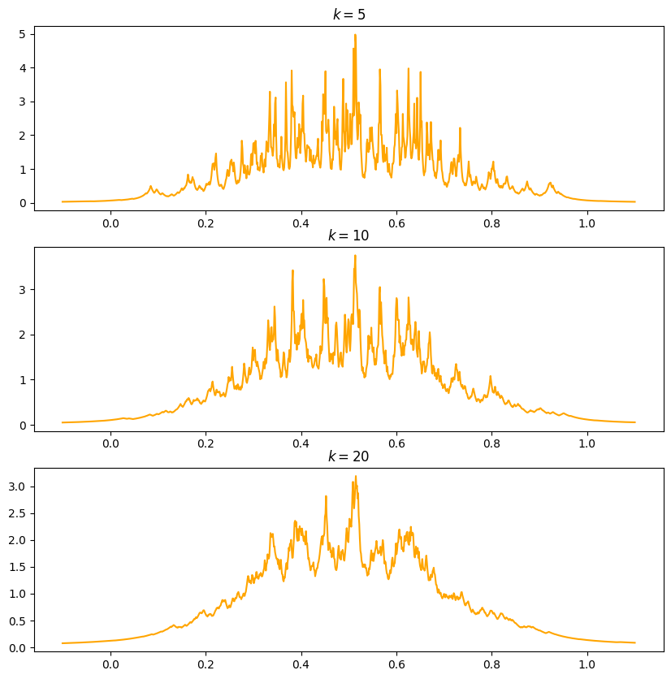
Output

Slide 11
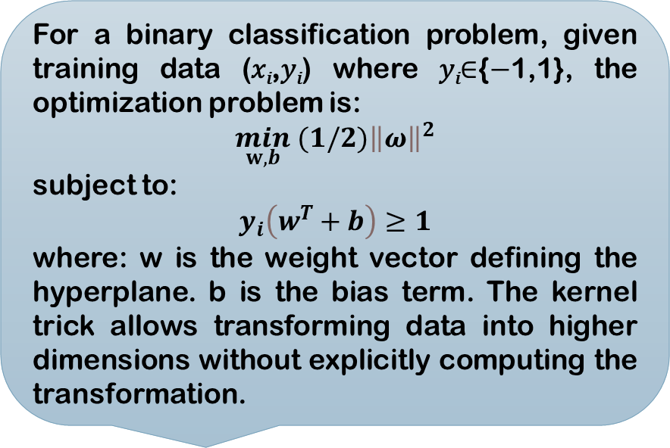
Support Vector Machines (SVM)
What is Nearest Neighbor Estimation?
Mathematical Formulation
For a binary classification problem, given training data (𝑥_{𝑖},𝑦_{𝑖}) where 𝑦_{𝑖}∈{−1,1}, the optimization problem is:
$$\min_{w,b} (1/2){\left\|ω\right\|}^{2}$$
subject to:
$$y_{i}\left(w^{T}+b\right)≥1$$
where: w is the weight vector defining the hyperplane. b is the bias term. The kernel trick allows transforming data into higher dimensions without explicitly computing the transformation.
SVM is a non-parametric supervised learning algorithm used for classification and regression.
It works by finding the optimal separating hyperplane that maximizes the margin between different classes.

Slide 12
Types of SVM
SVM
Linear SVM: Uses a linear hyperplane.
Non-linear SVM: Uses kernel functions like:
Polynomial Kernel
Gaussian (RBF) Kernel

Slide 13
Applications of svm
1
2
3
Text classification (e.g., spam detection).
Image recognition.
Medical diagnosis (e.g., cancer classification).

Slide 14
Example Code: SVM in Python
import numpy as np
import matplotlib.pyplot as plt
from sklearn import svm
# Generate sample data
np.random.seed(0)
X = np.r_[np.random.randn(20, 2) - [2, 2], np.random.randn(20, 2) + [2, 2]]
Y = [0] * 20 + [1] * 20
# Train SVM model with RBF kernel
clf = svm.SVC(kernel='rbf', C=1.0, gamma='scale')
clf.fit(X, Y)
# Plot decision boundary
xx, yy = np.meshgrid(np.linspace(-5, 5, 50), np.linspace(-5, 5, 50))
Z = clf.decision_function(np.c_[xx.ravel(), yy.ravel()])
Z = Z.reshape(xx.shape)
plt.scatter(X[:, 0], X[:, 1], c=Y, cmap=plt.cm.Paired)
plt.contour(xx, yy, Z, levels=[0], linewidths=2, colors='k')
plt.title("SVM Decision Boundary")
plt.show()

Slide 15
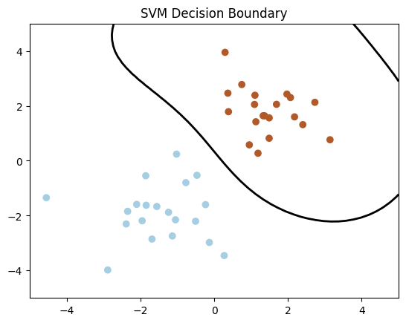
Output

Slide 16
Comparison: KNN vs. SVM
Feature | KNN Density Estimation | SVM
Flexibility | Very flexible but sensitive to k | Controlled flexibility via kernel
Computation | Expensive for large datasets | Efficient after training
Type | Unsupervised | Supervised
Purpose | Density Estimation | Classification/Regression
Parameters | Number of neighbors (k), distance metric | Kernel, C (regularization), Gamma

Slide 17
Advantages & Disadvantages of Non-Parametric Estimation Methods
✅ Advantages:
✔ No assumption about underlying distribution. ✔ More adaptive and flexible to real-world data. ✔ Works well for high-dimensional and irregular data.
❌ Disadvantages:
✘ More data needed for accurate estimation. ✘ Computationally expensive, especially for large datasets. ✘ Choice of bandwidth/smoothing parameters affects results.
📌 Key Takeaway: While flexible, non-parametric methods require careful tuning for accurate results.

Slide 18
Applications
📌 Density Estimation: Income distribution, species population density.
📌 Trend Analysis: Stock prices, climate data.
📌 Classification/Regression: Medical diagnosis (k-NN), real estate pricing.
📌 Hypothesis Testing: Non-parametric tests (Mann-Whitney U test).
📌 Visual: Real-world examples (e.g., KDE plot of income data).

Slide 19
Conclusion
KNN Density Estimation is useful for probability estimation and anomaly detection.
SVM is a powerful classification tool that works well with high-dimensional data using the kernel trick.
Both methods are widely used in practical machine learning applications.

Slide 20
REFERENCES
📘 "The Elements of Statistical Learning" – Trevor Hastie, Robert Tibshirani, Jerome Friedman
📗 "Pattern Recognition and Machine Learning" – Christopher Bishop
📙 "Nonparametric Statistical Methods" – Myunghee Cho Paik
📕 "All of Statistics: A Concise Course in Statistical Inference" – Larry Wasserman
📓 "Kernel Smoothing" – M. P. Wand, M. C. Jones
📔 "Learning with Kernels" – Bernhard Schölkopf, Alexander J. Smola
📖 "Support Vector Machines and Other Kernel-Based Learning Methods" – Nello Cristianini, John Shawe-Taylor
📚 "Understanding Machine Learning: From Theory to Algorithms" – Shai Shalev-Shwartz, Shai Ben-David

Slide 21



